Slide 1
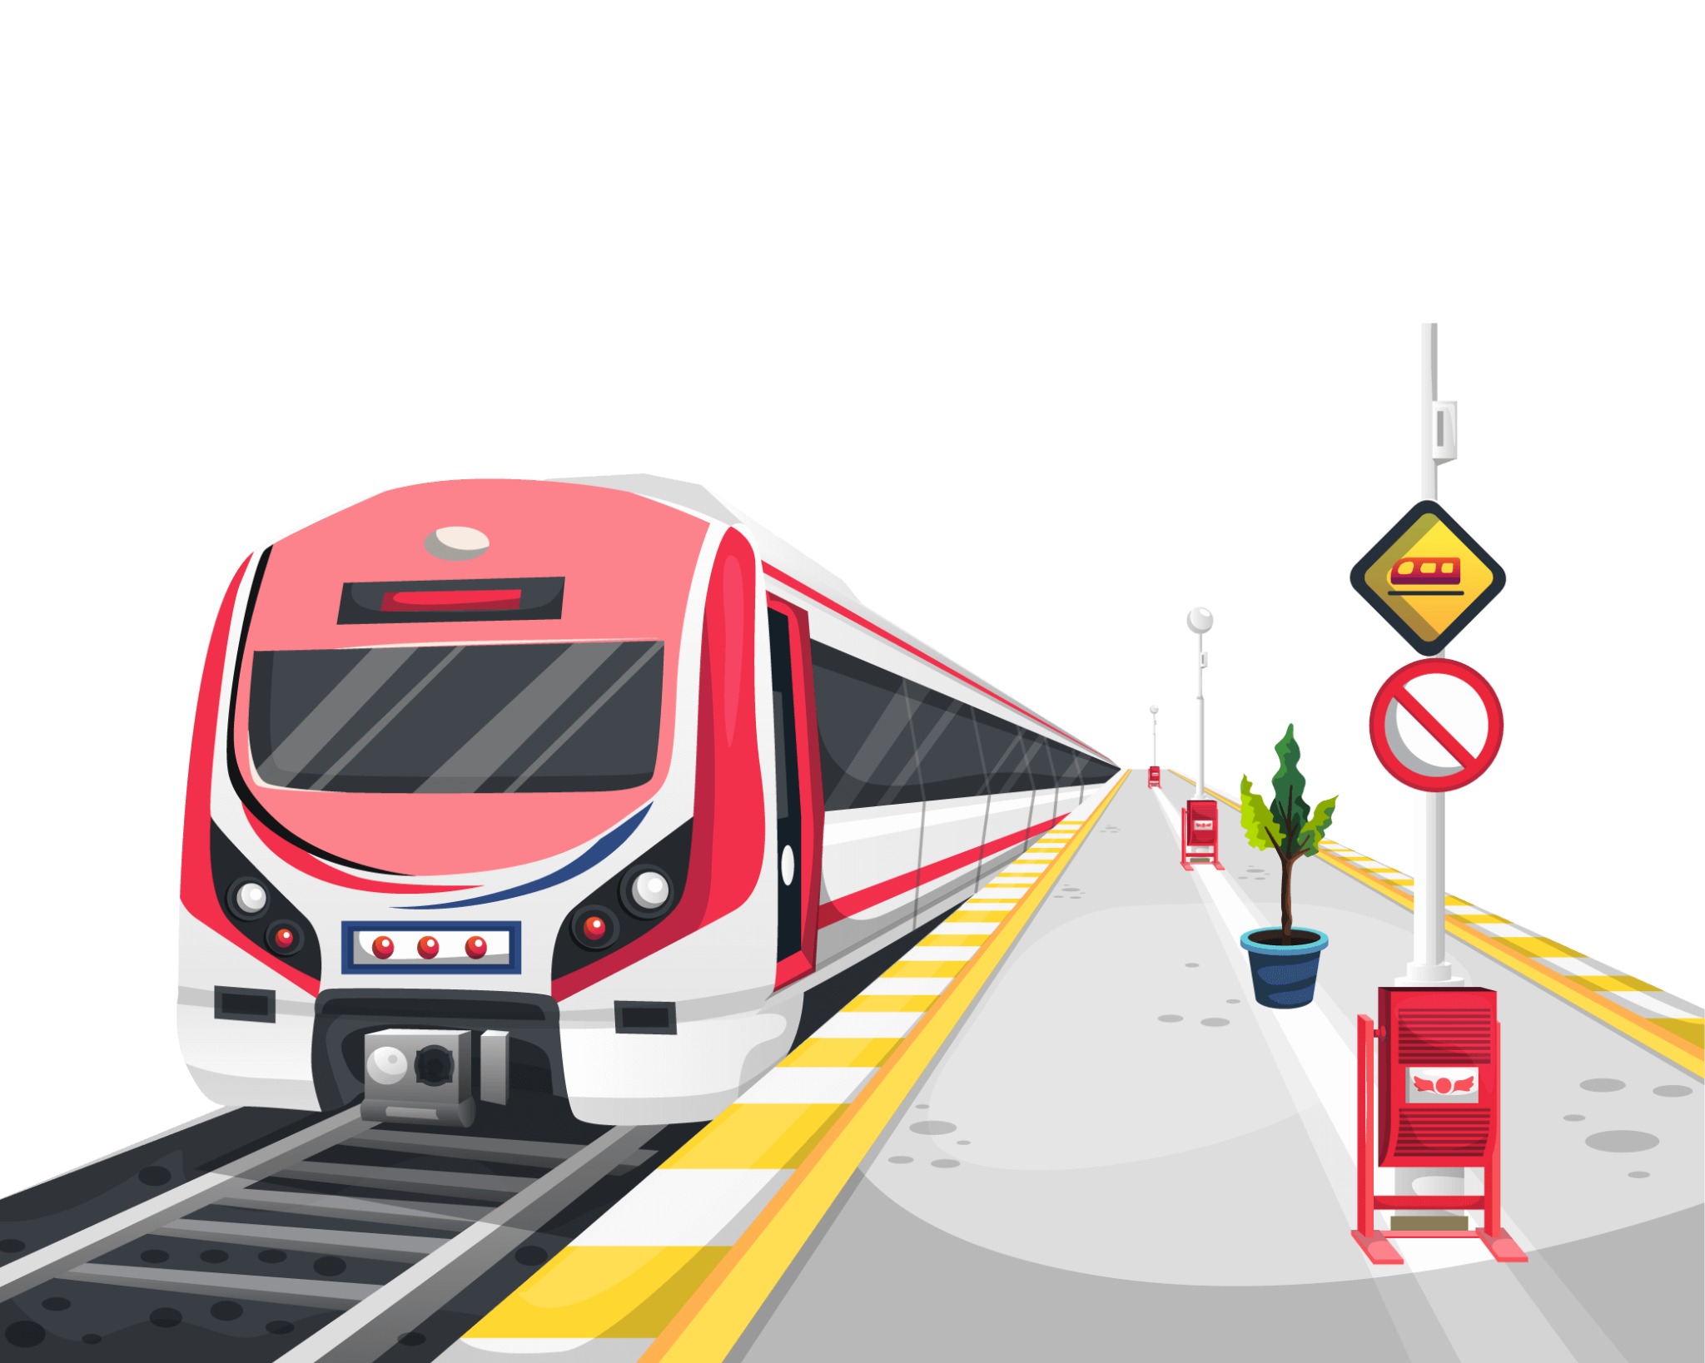
Metro Connect

Slide 2
OVERVIEW OF PROBLEM

Slide 3
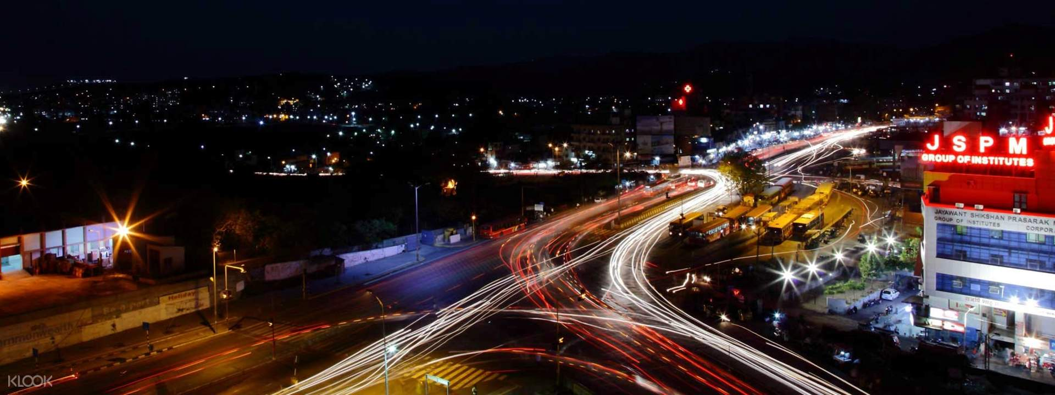
OVERVIEW OF PROBLEM
Pune is one of the fastest growing city in India . It is known for its vibrant culture, educational institutions, research centres and IT parks.

Slide 4
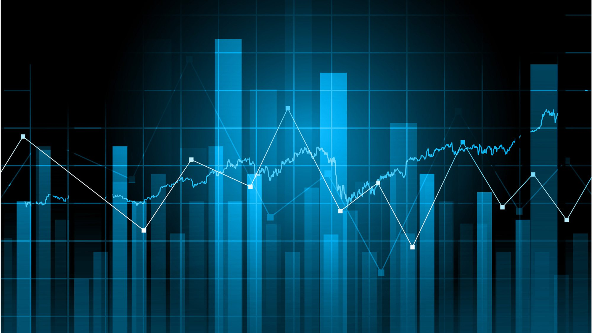
2) The TomTom Traffic Index Ranking 2022 has ranked Pune city as the sixth most congested city among 389 cities across 56 countries in the world.

Slide 5
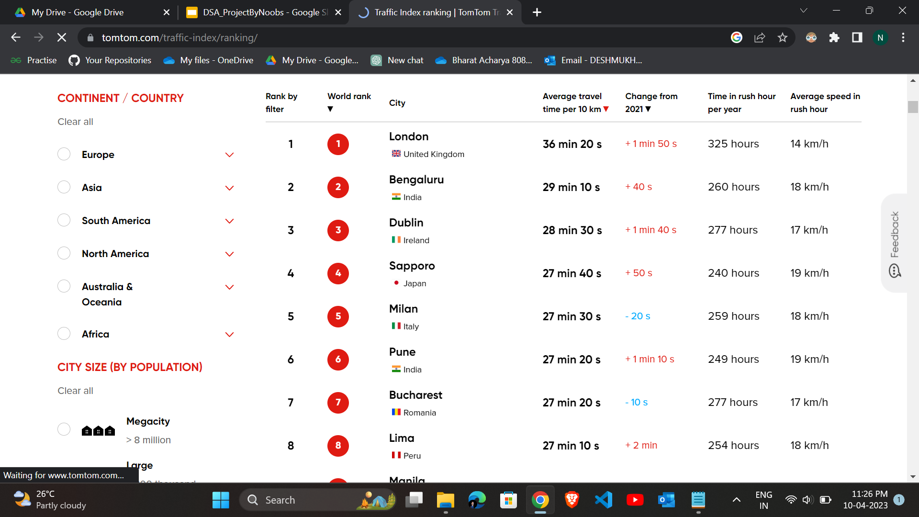
TOM TOM TRAFFIC INDEX

Slide 6
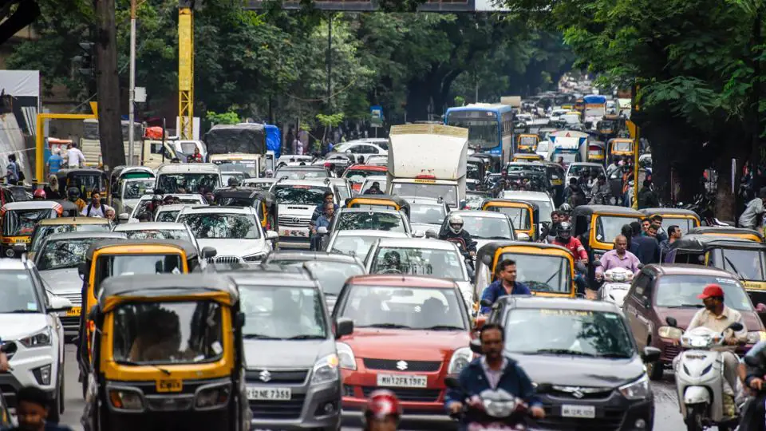
3) Traffic has been an issue affecting Pune for a long time and the situation has become more worse in the last few years due to the ongoing developmental activities.

Slide 7
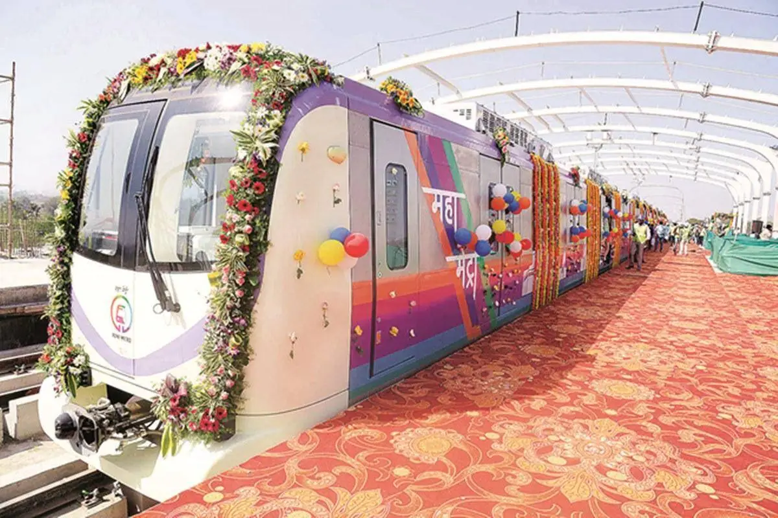
4) So as to reduce traffic congestion and improve mobility in the city , Pune metro was introduced . So Metro can be looked forward as an alternative to reduce the traffic problems.

Slide 8

PROBLEM STATEMENT

Slide 9
The Actual Problem Statement.
Passengers find it difficult to search a metro station nearest to them.
Even after finding a metro , it needs to be of the correct destination station.
If the passenger wants to get down before the final station i.e at any random station that falls on the route, he/she needs to know the route of the metro.
Overall, passengers need to be physically present at the metro station in order to understand the routes and metro timings.
There is no way for the passengers to have all the information at their fingertips within a fraction of second.

Slide 10
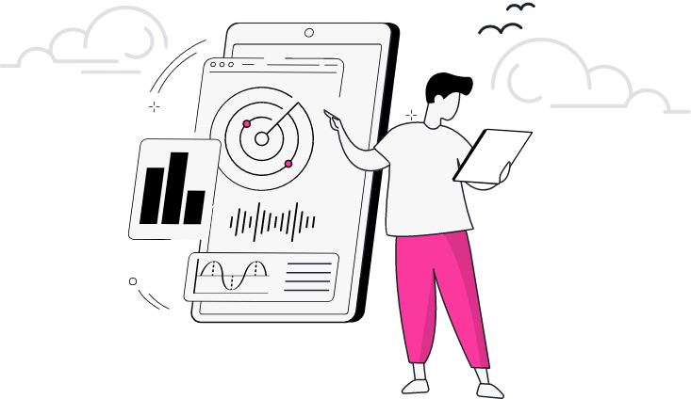
RESEARCH

Slide 11

USER BEHAVIOUR AND NEED
Needs & pain points of users :
Less metro routes are working , many of metro construction work is still going on , so currently metro is efficient only for small routes .
2) Lack of Timings of Metro .
3) Less Frequency of Metro .
4) People had less knowledge about extent of metro routes as it is under-developing .

Slide 12

SOLUTION

Slide 13
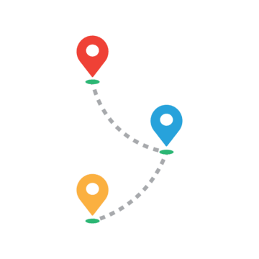
Metro Route Finder using Graphs Traversal methods
This project is aimed to be assistant for daily commuters , help them in reaching their desired destination via Metro .
It will use Graphs traversal methods for finding shortest path between source and destination nodes.
Along with it , using some allied data structures , multiple other assisting features can be developed .

Slide 14
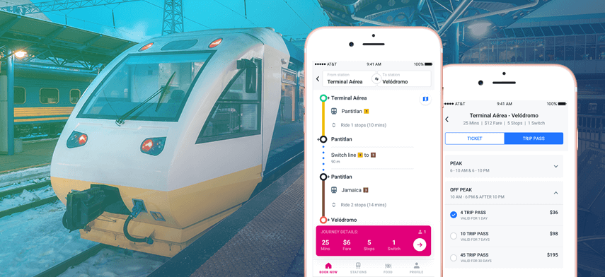
Metro Assistant Application
Metro app is meant to be a one-stop destination that helps users to search metro routes between two metro stations, view metro station details, search nearest metro stations… basically everything related to metro.

Slide 15

BENEFITS

Slide 16
Ease for searching routes.
Easy access to metro maps - Which will always be updated according to recent developments.
Locating nearby metro stations.
An assistant that helps us in changing the mode of travel.
It will increase the number of people travelling by metro. Thus, leading to an increased response for the Pune metro.
By looking at the increased response , Government can increase the number of trips & Eventually the road traffic will get reduced.

Slide 17

CHALLENGES

Slide 18
To make a complete User friendly system .
To inculcate a Recommendation system that analyzes user and suggests him better.
To make travel secure , to build a one tap service that helps user whenever he/she is in trouble by informing nearest Police station about the location of user .

Slide 19
Research Papers Reference
This research paper work is based on Delhi Metro . Referring this we will be implementing the same with some additionals on Pune Metro
https://ijcrt.org/papers/IJCRT2106513.pdf
https://www.diva-portal.org/smash/get/diva2:575113/FULLTEXT05.pdf
https://www.punemetrorail.org/download/PuneMetro-DPR.pdf

Slide 20
Pune Metro Stations:-
AQUA LINE :
1.Vanaz
2.Anand Nagar
3.Ideal Colony
4.Nal stop
5.Garware College
6.Deccan Gymkhana
7.Sambhaji Park
8.PMC
9.Civil court
10.Mangalwar Peth
11.Pune railway station

Slide 21
12.Ruby Hall Clinic
13.Bund Garden
14.Yerawada
15.Kalyani Nagar
16.Ramwadi
PURPLE LINE
1.PCMC
2.Sant Tukaram Nagar
3.Bhosari
4.Kasarwadi
5.Phugewadi
6.Bopodi

Slide 22
7.Khadki
8.Range Hills
9.Shivaji Nagar
10.Civil Court
11.Budhwar Peth
12.Mandai
13.Swargate

Slide 23
TIMELINE
PAST:
Understanding metro routes and their specifications was very difficult.
Physical presence of the person was necessary at the metro station for him/her to understand the metro timings and the routes .
PRESENT:
Working on innovative solutions to solve problems face by users using data structure and algorithms.
Use of Graph data structure. Using locations as nodes in graphs and weighted edges to represent the distance between the same.
Usage of various graph traversal techniques to find a route.
Usage of other allied data structures for Metro timing purposes.

Slide 24
FUTURE:
Novelties that can be added to the solution to make it more & more effective. Eg. Citi darshan, parking arrangement, etc
Implementation of the designed solution.

Slide 25
Data Structures to be Used :
1)Graphs
2)Trie
3)Breadth-First-Search algorithm

Slide 26
Novelty -
City Darshan Tourism Plan
Parking facility near metro stations

Slide 27
Call of Action
We know most of the people in pune are not from pune, but from outside pune.
Most of them are here for education and jobs......
Who are just mere starters in their career.....

Slide 28
So for all of them....
It is expected that the students and job professionals are punctual to their respective workplace, but amongst the ‘PUNE TRAFFIC’ , it becomes almost impossible to be on time. So the Pune metro is the ultimate choice for them to avoid the traffic. So for the ease of the passengers and the benefits that the pune metro has to offer them.... The Metro Connect app is the way.

Slide 29
A PROJECT BY:-
SARTHAK ADESH RANAWADE

